Slide 1

Google Analytics Customer Revenue Prediction
2018 Fall Data Science Capstone DATS 6501
Cheng Miao
Professor: Amir Hossein Jafari

Slide 2
Introduction and Object
This project is created to predict the Google Store Customer Revenue based on machine learning methods(Predict how much GStore customers will spend).
The outcome will be more actionable operational changes and a better use of marketing budgets for those companies who choose to use data analysis on top of GA data.
The object for this project is to implement learned machine learning knowledge in class and explore new knowledge.
Compare the advantages and disadvantages of using the model in the project.
Make data analysis and give advice to some companies.

Slide 3
Dataset
Google Analytics Customer Revenue Prediction
Dataset link: https://www.kaggle.com/c/ga-customer-revenue-prediction/data
The data has 50 columns, with “transaction Revenue” as the target to explore the relationship between the rest of the dataset.
Dataset has factors such as Visitor ID, Country, Mobile, Week, etc.

Slide 4
Problem Statement
Which factors will have higher impact on model?
How does model performance?
Any advice to companies?
Packages:Numpy, Pandas, Matplotlib, Sklearn, Json, Seaborn, torch, lightGBM, etc

Slide 5
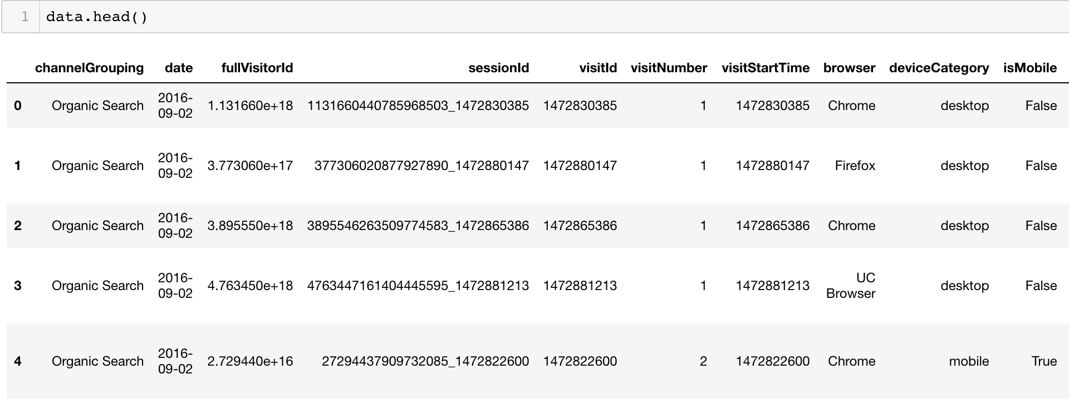
Dataset
How dataset looks like

Slide 6
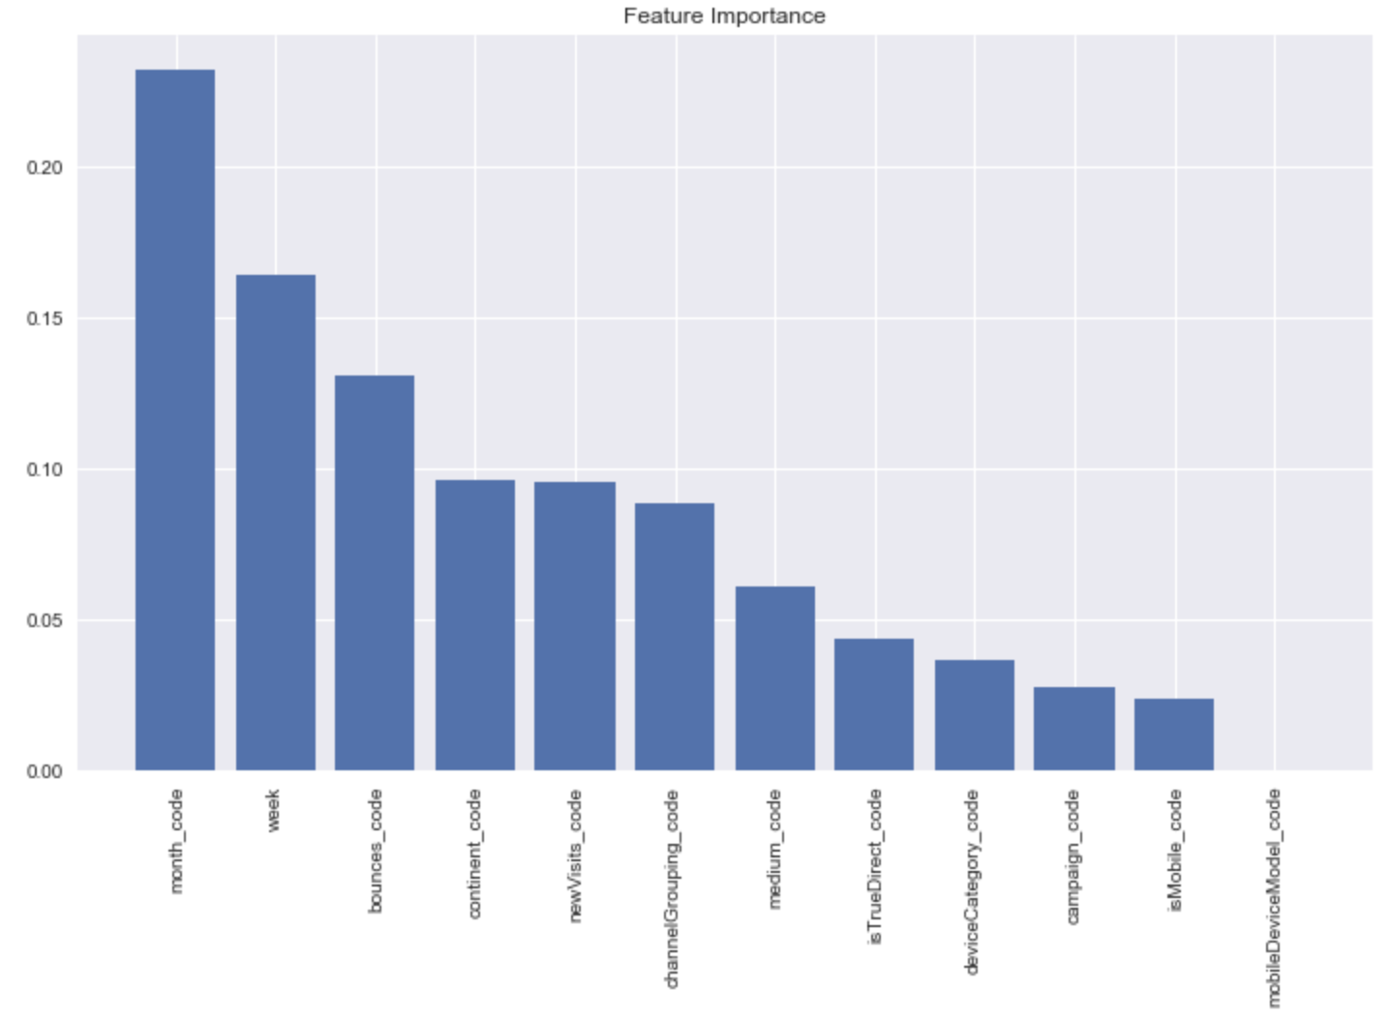
Data Preprocessing: Random Forest- Feature Importance

Slide 7
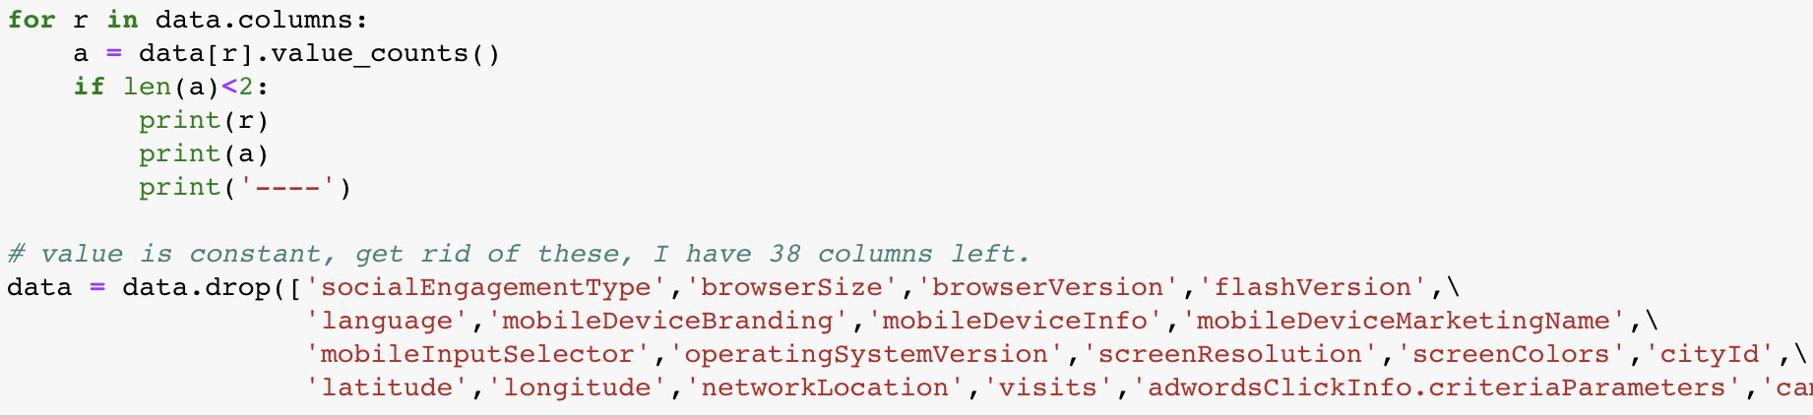
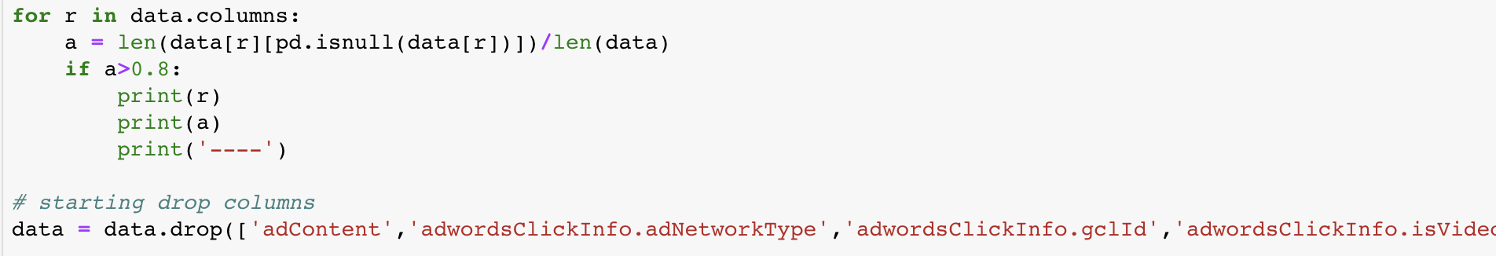
Data Preprocessing
Data Preprocessing really important, it may takes around 60% time of a project.

Slide 8
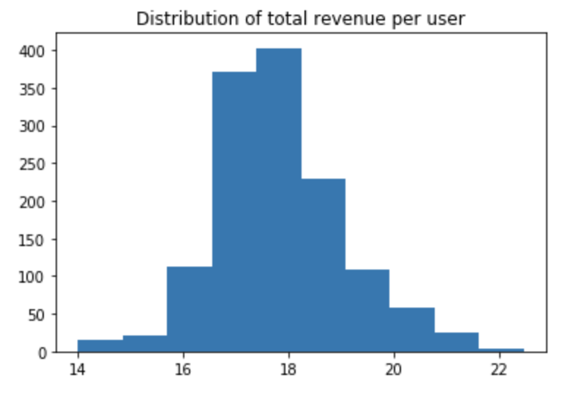
Exploratory Data Analysis (EDA)
it is more useful to see a distribution of total revenue per user
See the total revenue per user focus on 16 to 19 presenting a normal distribution.

Slide 9
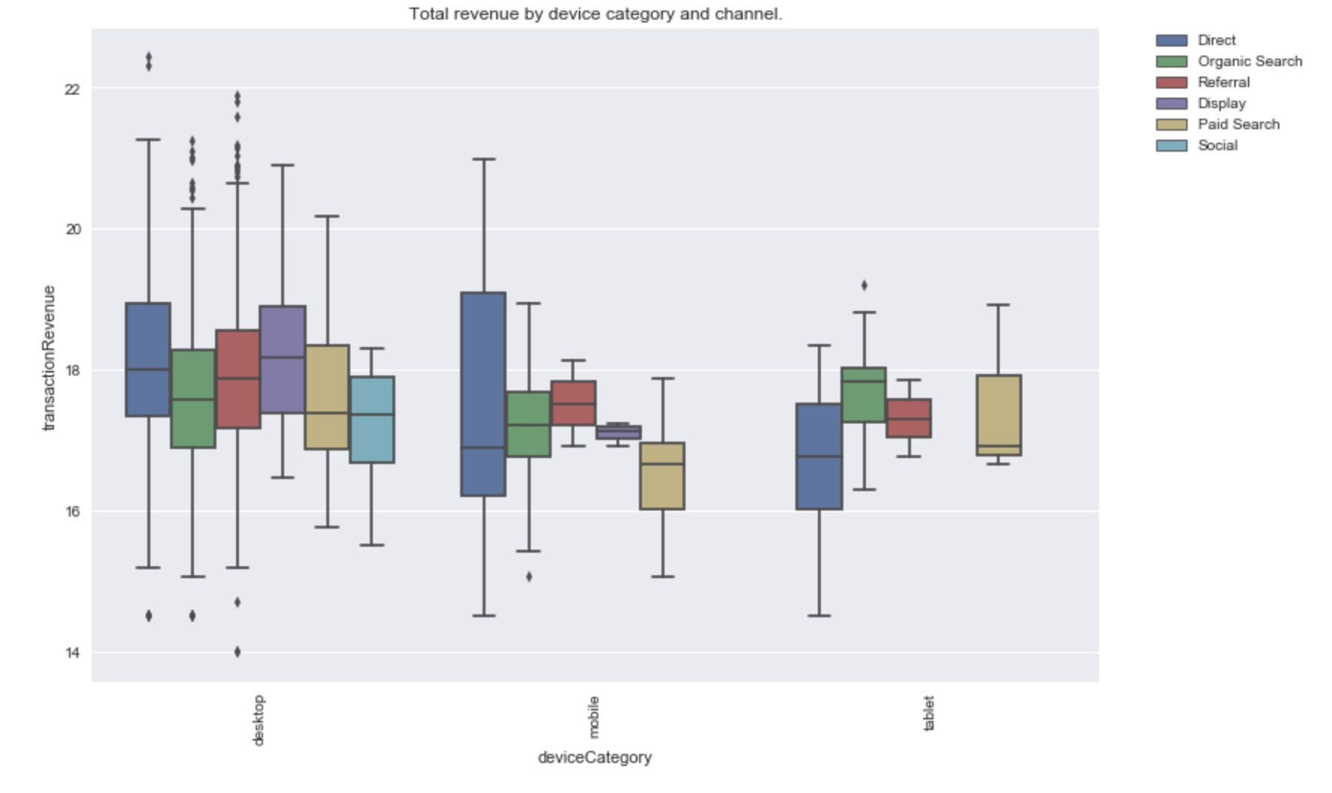
Exploratory Data Analysis (EDA)
Revenue comes mostly from desktops. Social, Affiliates and others aren't as profitable as other channels

Slide 10
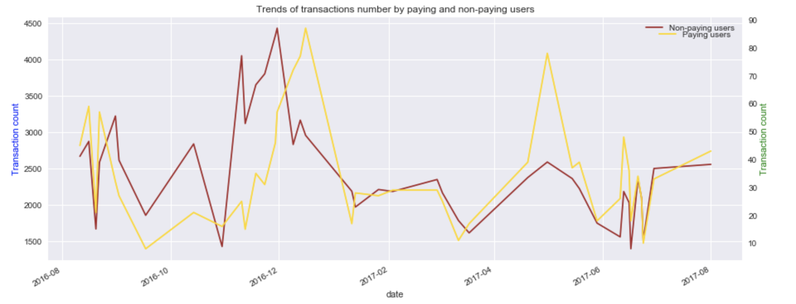
Exploratory Data Analysis (EDA)
It is that trends of non-paying users and paying users of paid transactions are almost similar.
There are several periods when the number of non-paying users was significantly higher that the number of paying users.

Slide 11
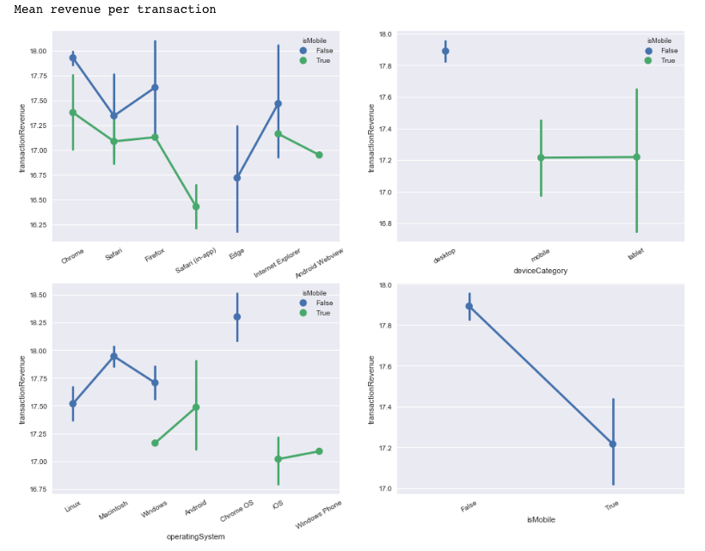
Exploratory Data Analysis (EDA)
The top-left graph shows devices on Chrome, Safari and Firefox could bring profit.
Left corner graph looks that devices on Chrome OS and Macs bring most profit.
Top-right graph, mobile and tablet bring most profit.

Slide 12
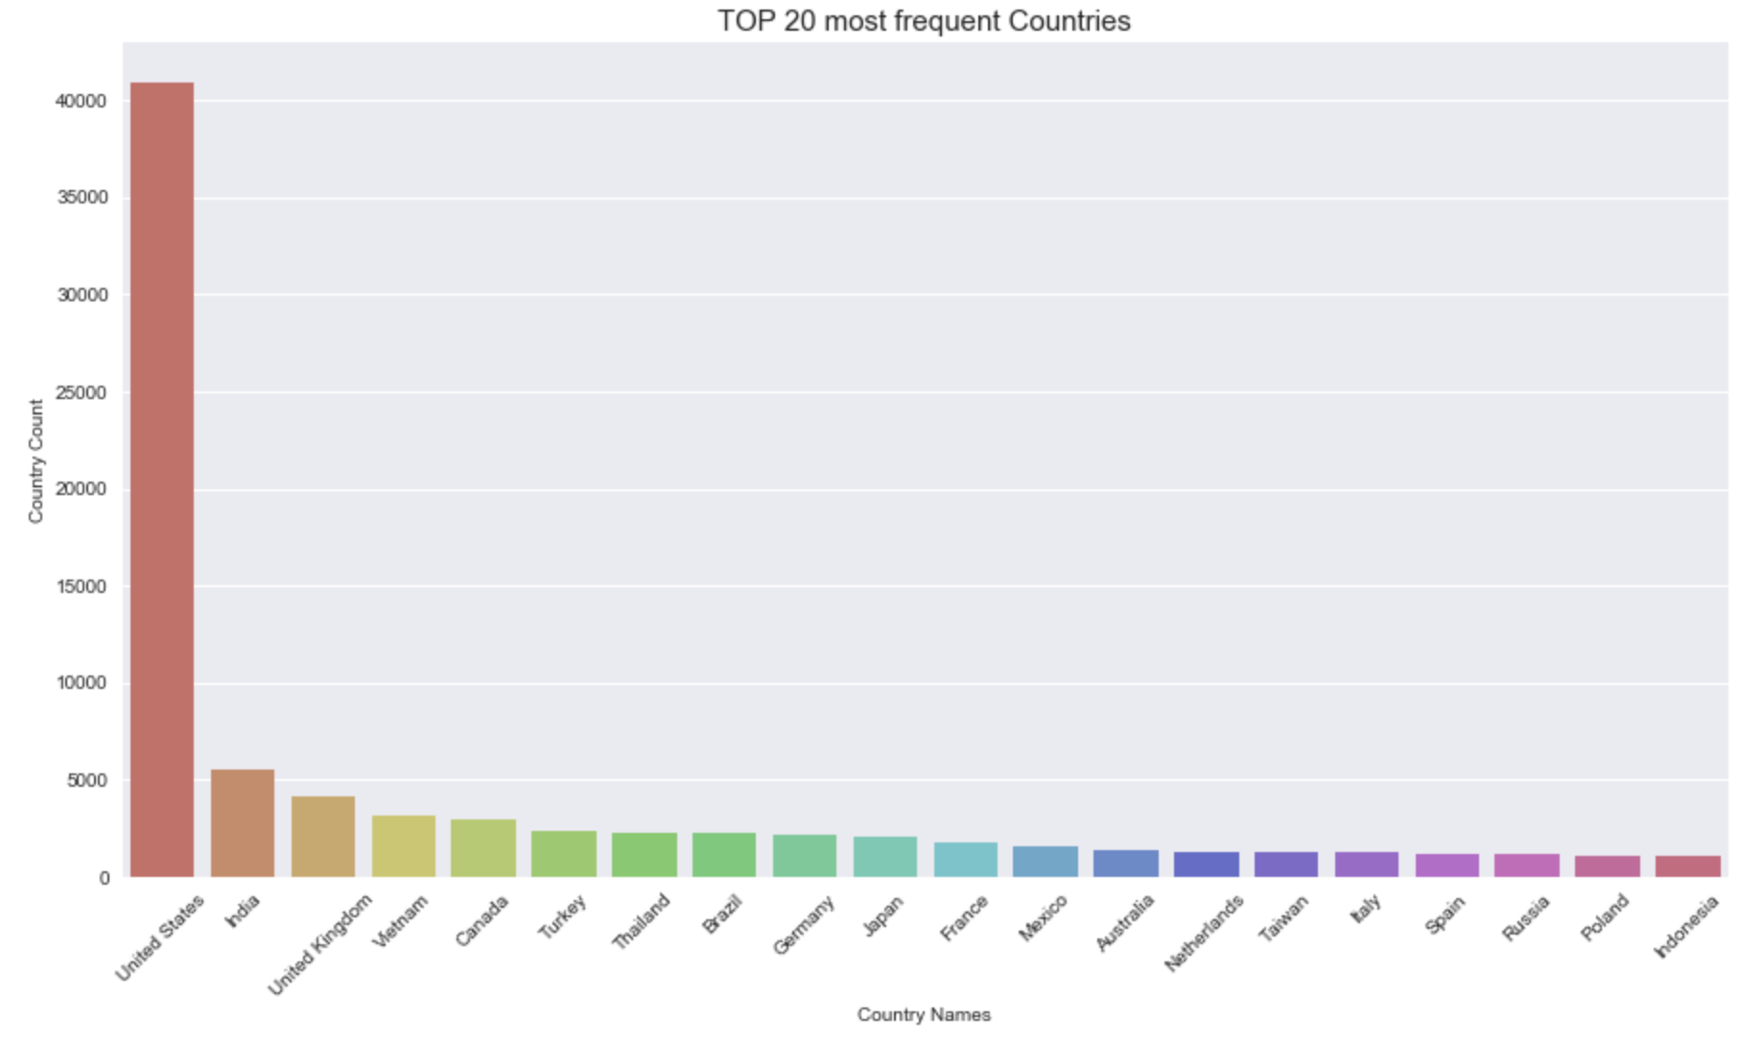
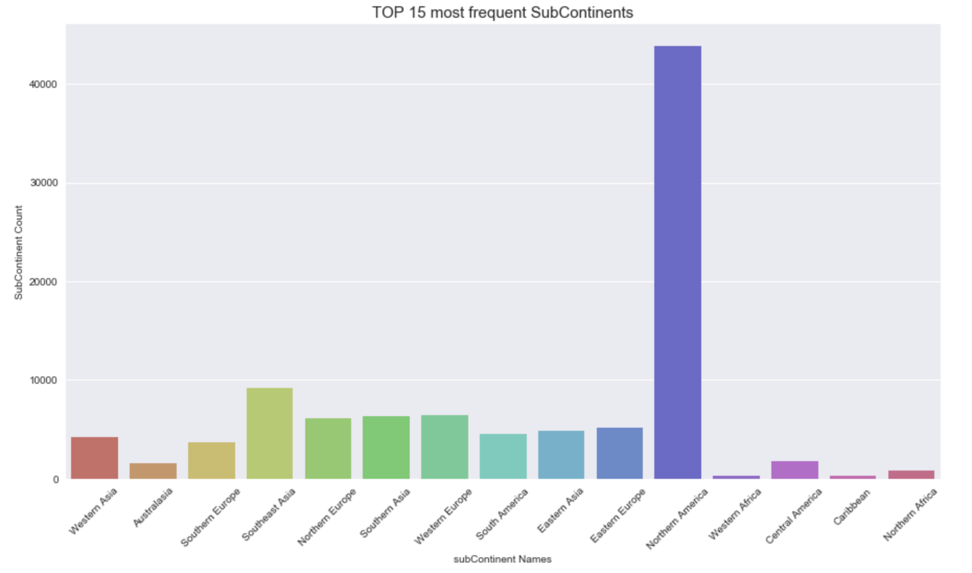
Exploratory Data Analysis (EDA)
The above graph shows the top 20 most frequent countries. The United States stands out in the world and has the highest frequency.
This bottom graph shows the top 15 most frequent Sub Continents, the Northern America has the most frequencies in the world.

Slide 13
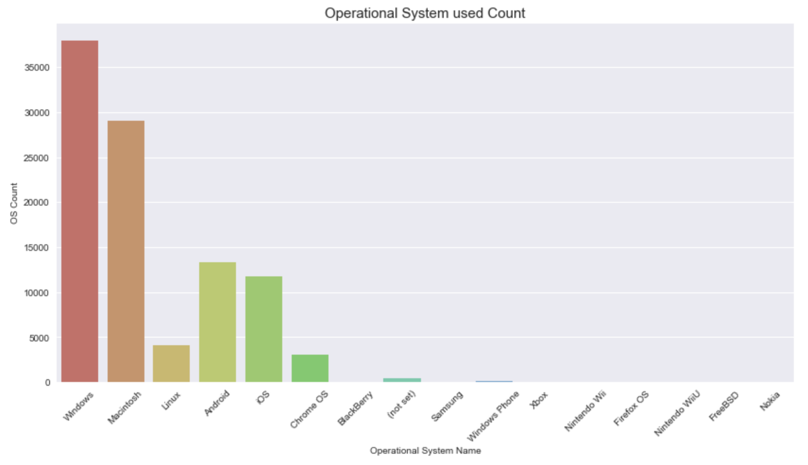
Exploratory Data Analysis (EDA)
This graph shows the operational system used count bar chart. Windows and Mac operational system there are the top two operational system

Slide 14
Methodology
Light GBM
Random Forest
Multi-layer perceptron - Feed forward Neural Network

Slide 15
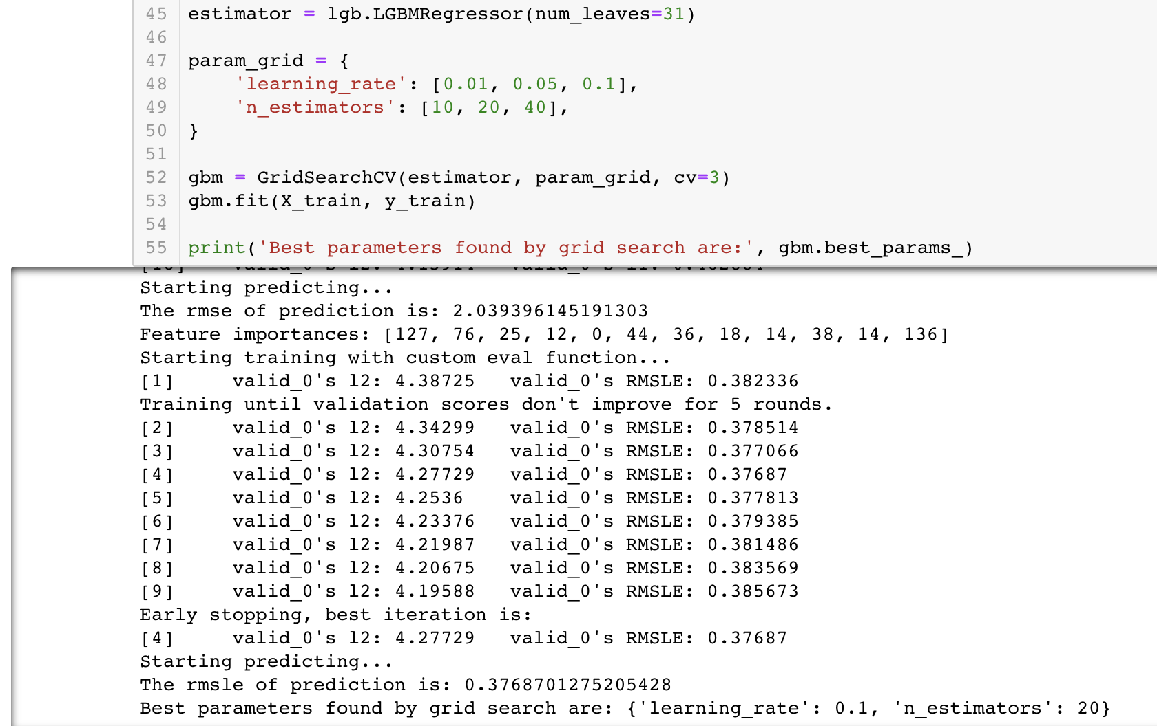
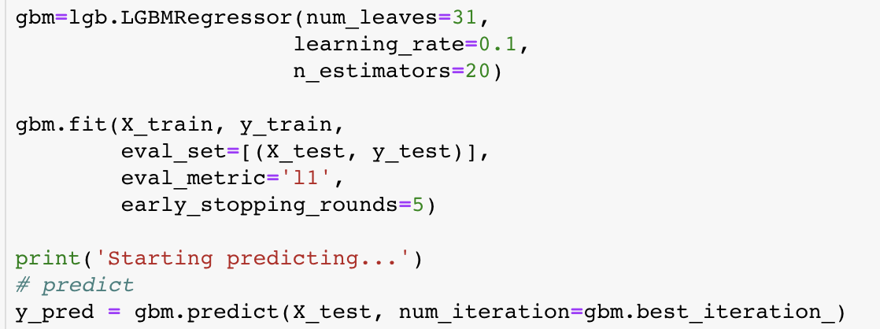
Light GBM
Used grid search to select the appropriate model parameters.
Learning rate is 0.1 and the n_estimators selection is 20.
Bring this parameter into the LGBM Regressor to train my model.

Slide 16
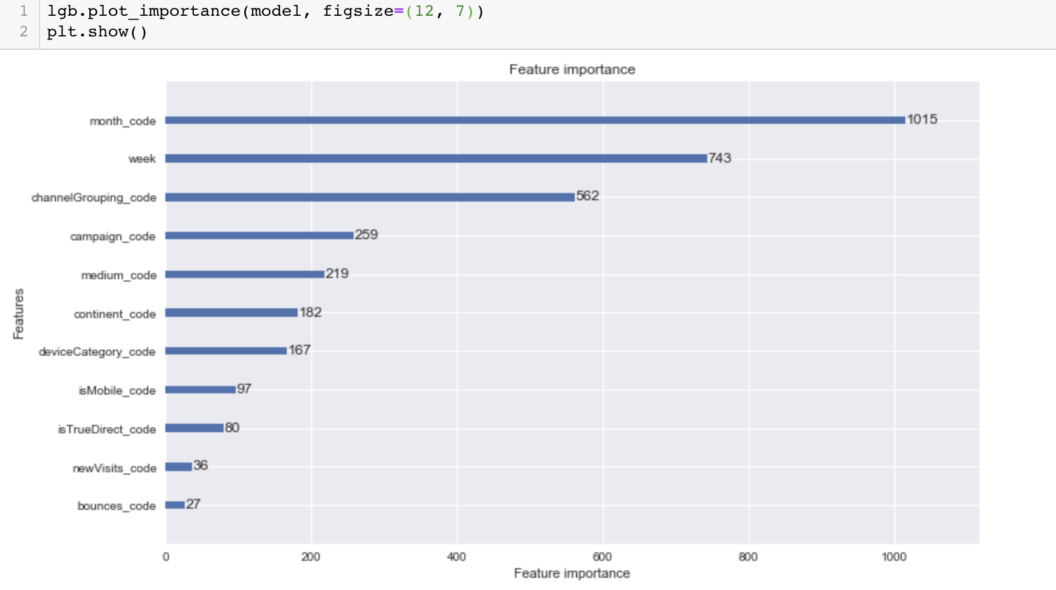
Light GBM – Feature Importance

Slide 17
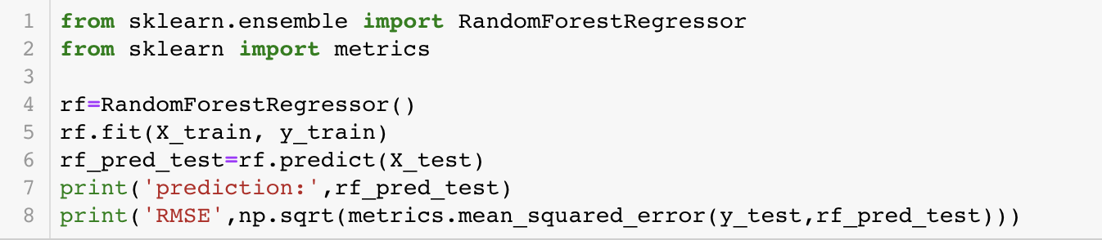
Random Forest

Slide 18
Principal Component Analysis (PCA)
Use PCA to make the data on dimensionality reduction

Slide 19
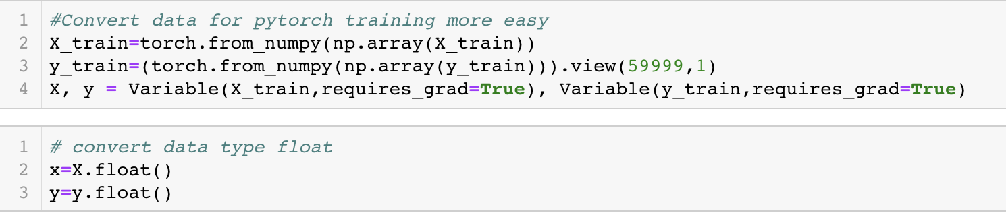
Multilayer Feed-Forward Neural Network
Convert the data into a torch format suitable for the Pytorch framework, in order to work on training and make prediction.
Before inputting to the neural network as input, I have to convert the data to float

Slide 20
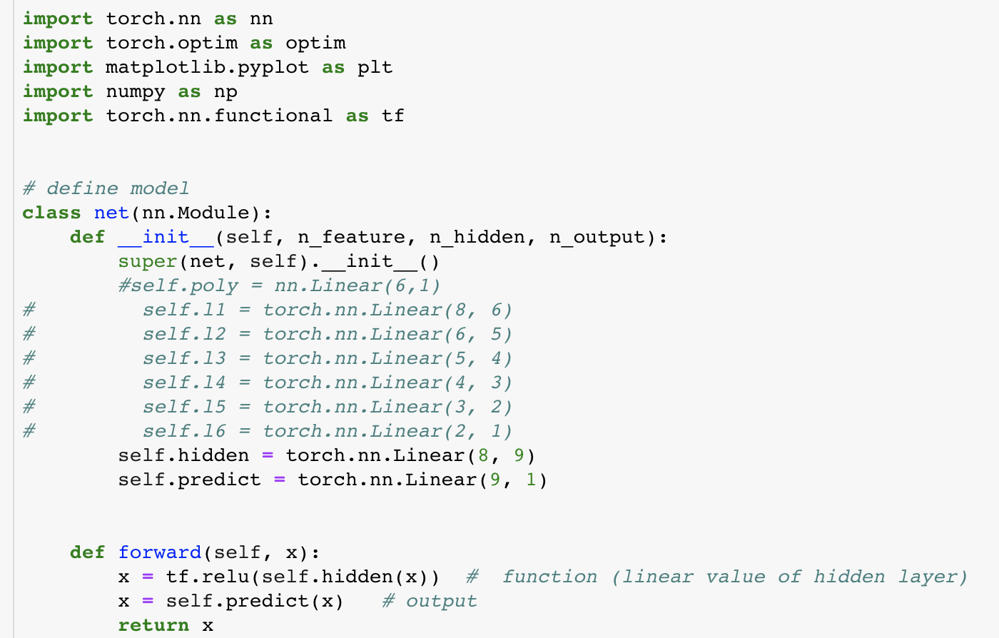
Multilayer Feed-Forward Neural Network: Define Model
Define the Neural Network model refers to a lot of research online
n_feature s=8, 9 is hidden layer.
This parameter can be conditional.
The hidden layer can be adjusted from 1 to 100. Due to its limited capacity, it is temporarily set to 9. The output is 1

Slide 21

Multilayer Feed-Forward Neural Network: Train Model
Here is criterion and optimizer
Loss is too high

Slide 22
Adjust Loss: Research and Tuning Hyper-parameters
Data standardized: standardization of data refers to scaling the data to make it fall into a specific interval
Adjust optimizer
Set different learning rates for different layers
Create a new optimizer and adjust the learning rate

Slide 23
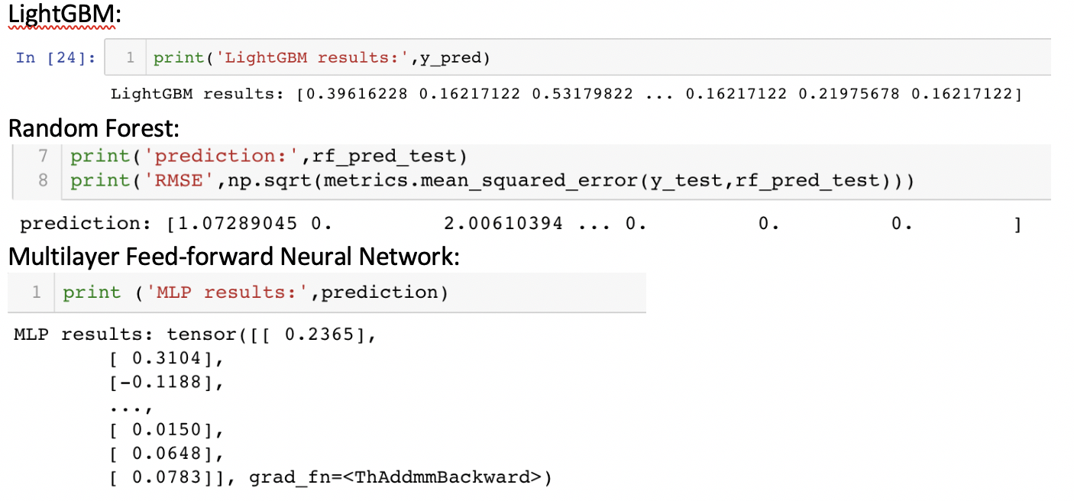
Prediction Results

Slide 24
What I Learn From Project
LightGBM and Random Forest are Ensemble Learning
LightGBM: Takes up less memory and has less complexity in data separation.
Random Forest: it performs well and has high precision on large dataset; it is not easy to have over-fitting; it can get the order of importance of features
Multi-layer feed forward neural network: The network essentially implements a mapping function from input to output, and mathematical theory has proven to have the ability to implement any complex nonlinear mapping.
Adjust Parameters.

Slide 25
Advice to Companies
Customer spending is concentrated on non-mobile platforms, but mobile platforms have great potential.
With the rapid development of mobile phones, users will increase their consumption on mobile platforms.
Due to the significant number of users in North America, some applications in other regions can be added.

Slide 26
Reference
Kaggle:
https://www.kaggle.com/c/ga-customer-revenue-prediction
LightGBM https://github.com/Microsoft/LightGBM/blob/master/examples/python-guide/sklearn_example.py
Pytorch
https://github.com/MorvanZhou/PyTorch-Tutorial

Slide 27
Question ?

Slide 28

Thank You

